Slide 1
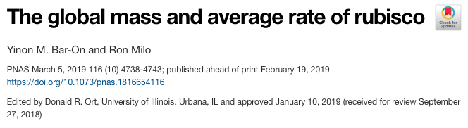

Slide 4
Conclusions
Total Rubisco is 0.7 Gt
Order of magnitude higher than previous estimate
Catalytic rate of Rubisco is 1% of maximum (lab)
Not always light out
Not always hot
Rubisco as storage?
Others?

Slide 5
